Slide 1

How can I help my child to prepare for September?
Come
Come to a story session and an activity session this term.
Talk about
Talk about starting school.
Walk
Walk the journey to school together over the Summer.
Read
Read stories together about starting school.
Try on
Try on uniform including PE kit (- trainers with Velcro fastenings)
Practise
Practise recognising their name and clearly label all uniform items.
Refer
Refer to information on the St Peter’s school website.

Slide 2

What will my child’s first few days/weeks in school look like?
Children into school via the classroom doors, followed by a toileting routine including handwashing. Your child will go to the cloakroom to hang up their own coat and belongings, then self register by finding their name card and placing it on a number line or in a box.
Your child will be invited to choose from a range of activities set out for them, including access to the outdoor learning area.
At times, children will sit as a class for whole class teaching, to hear a story, sing some familiar rhymes or participate in a discussion.
There will be an abundance of opportunities to build relationships with the staff team and their peers.
Your child will become familiar with routines and expected behaviours across areas of the early years setting, including rules for good listening, turn-taking, toileting and eating lunch.
During the first few weeks the children will be observed closely by their class teachers and engage in activities on a one to one basis so that a “Baseline Assessment” can be completed.
Notes:
VW

Slide 3
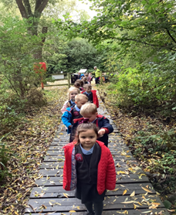
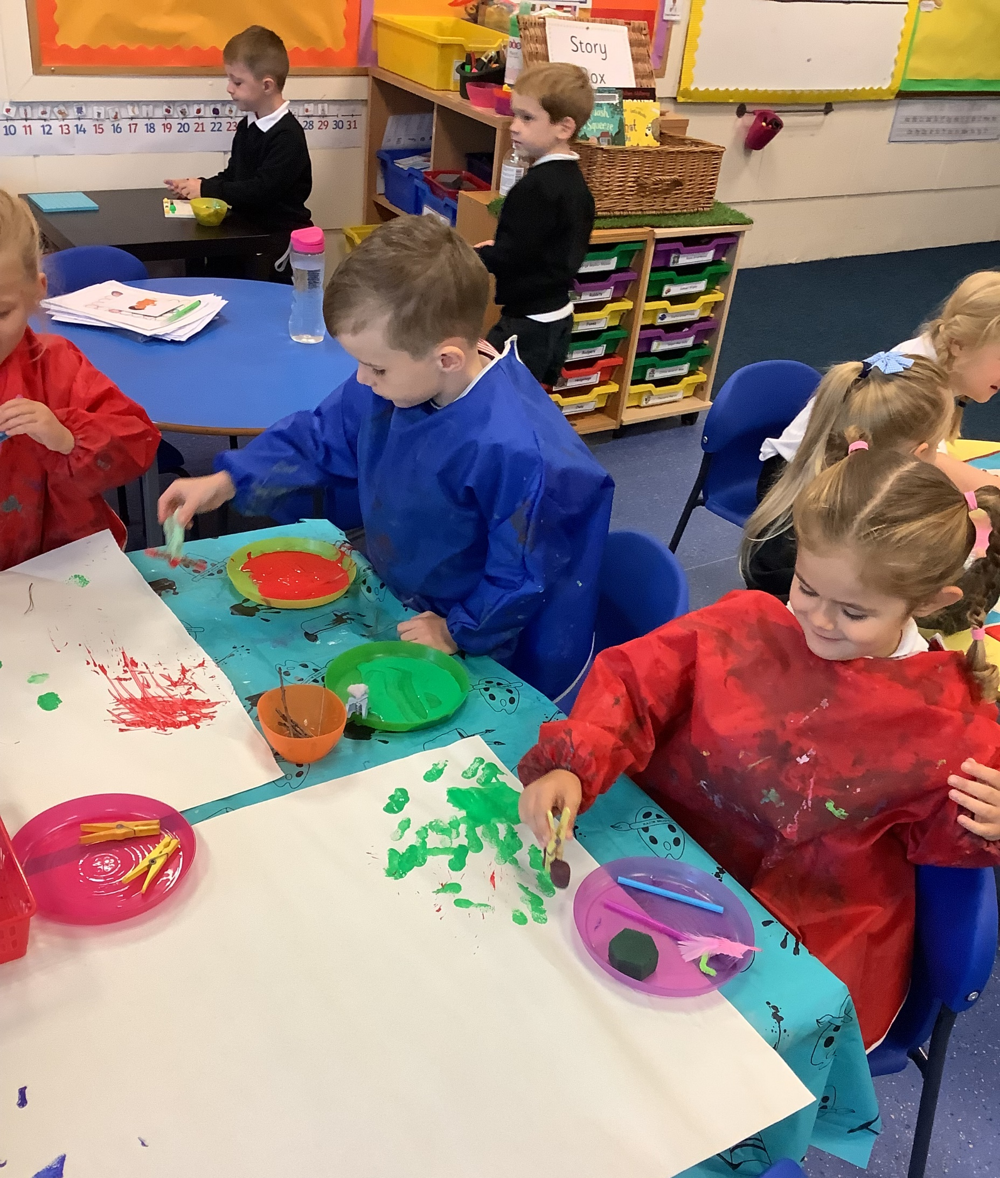
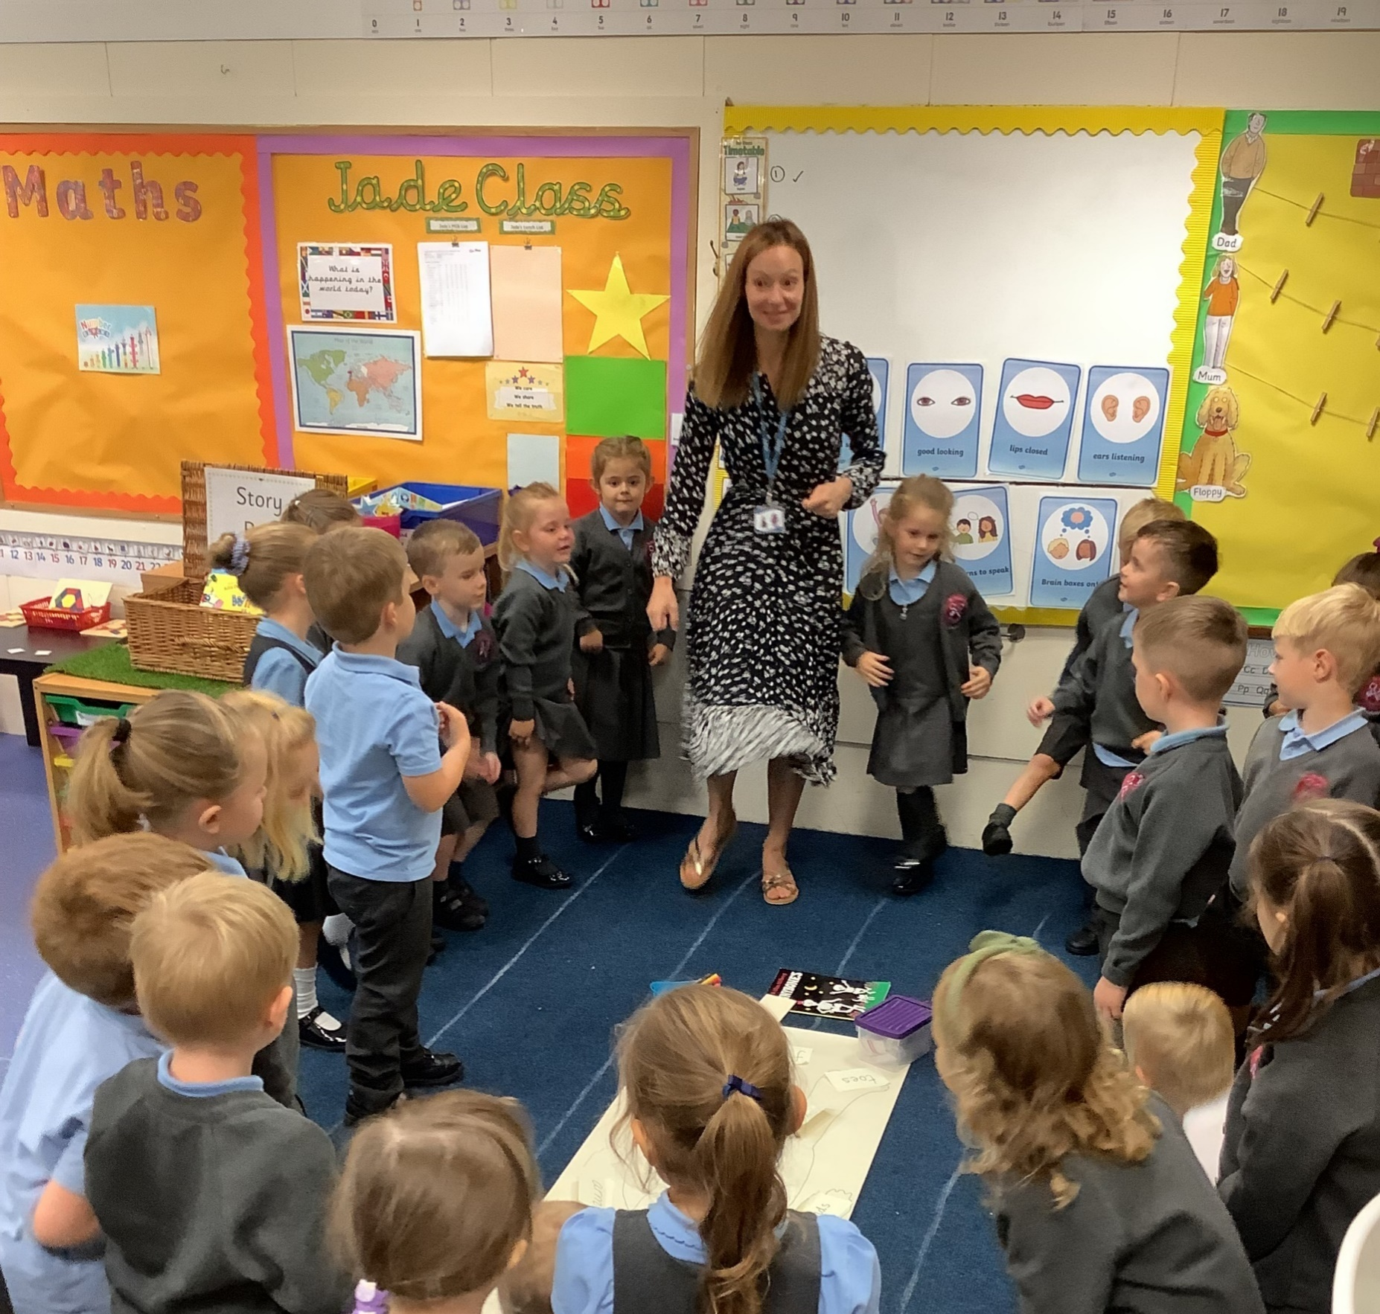
A typical day in Reception at St Peter’s
School starts at 8.40 am (Doors open at 8.30am) – Register and welcome
Phonics
Learning activities – inside and outside (independent choosing and an adult led focus activity)
Whole school Collective worship
Milk and fruit
Learning activities– inside and outside(independent choosing and an adult led focus activity)
Story / singing or topic discussion.
The morning session ends at 11.45am
Notes:
VW

Slide 4
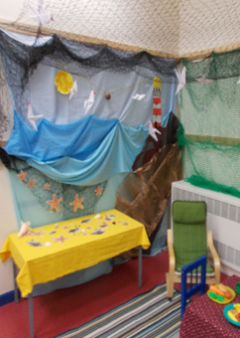
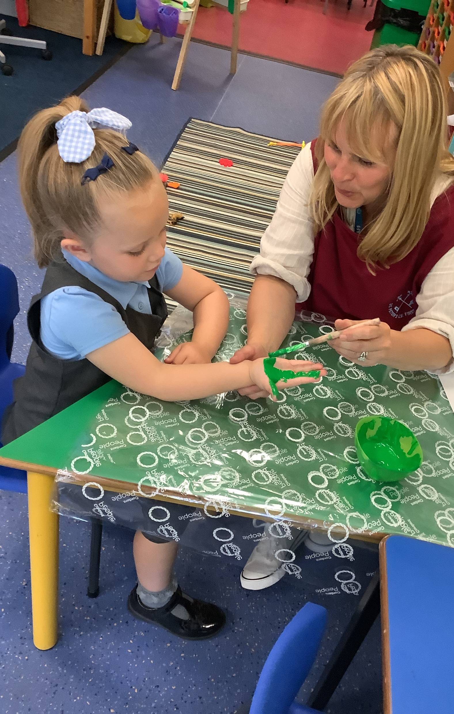
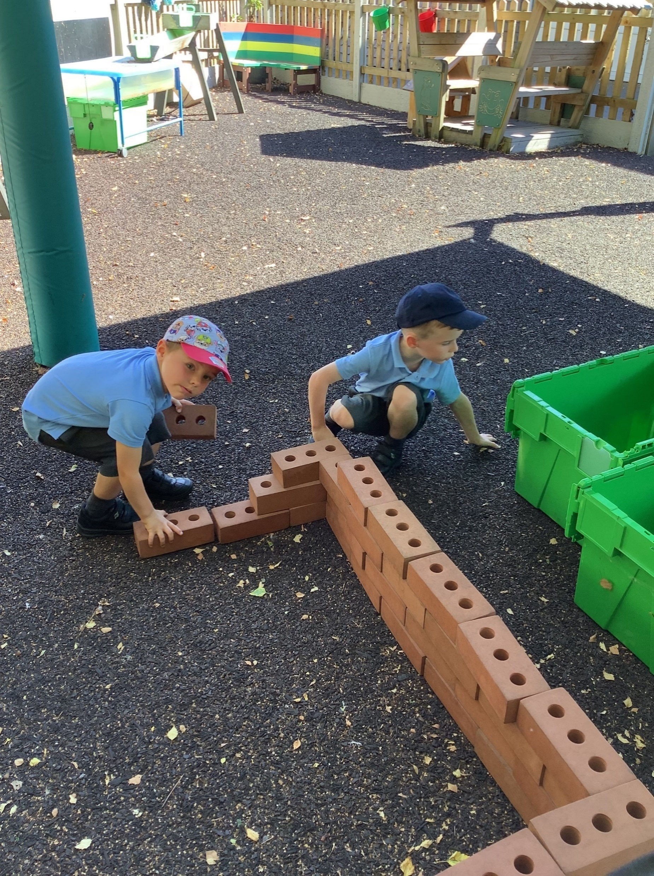
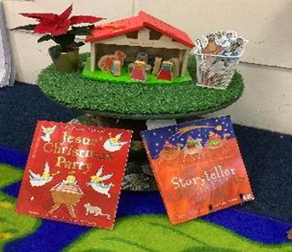
A typical day in Reception at St Peters
Lunchtime – FOOD and PLAYTIME.
The afternoon session begins at 12.45pm
Register and relaxation
Maths
Learning activities – inside and outside (independent choosing and an adult led focus activity)
Carpet time – topic discussion/ PSHE/Music
Learning activities – inside and outside (independent choosing and an adult led focus activity)
story/ singing,
Home time -3.00pm.
Notes:
VW

