Slide 1
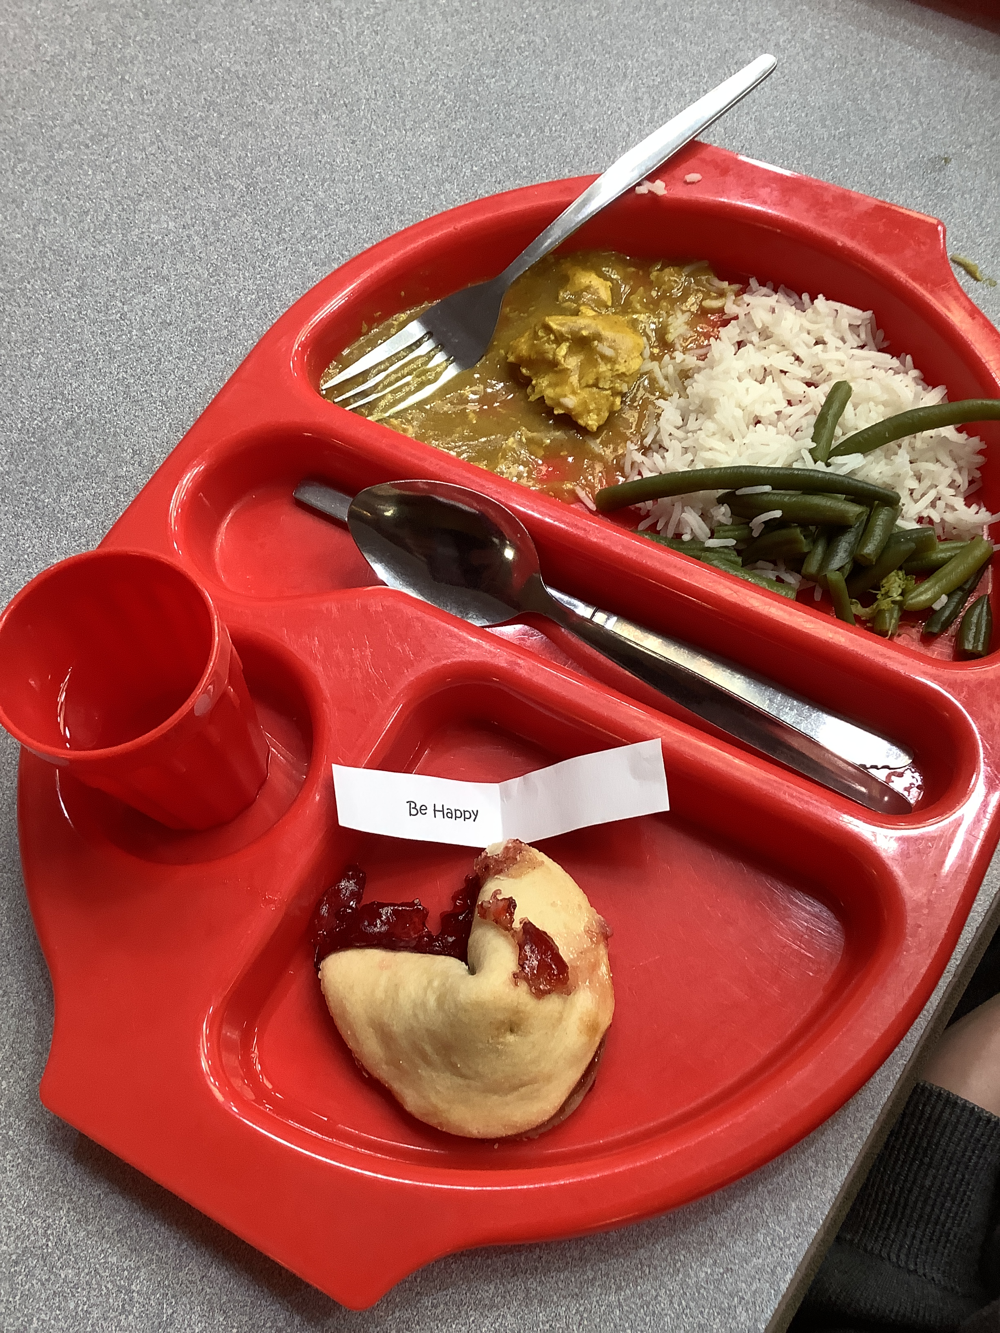
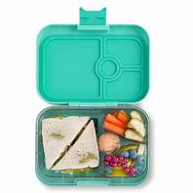
Lunchtime
Currently all children are eligible for a free daily healthy meal (up until the end of Year 2) which is supplied by an external provider.
Even though there is no cost for EYFS lunches, menu choices are booked via ParentPay. ParentPay is the online payment platform that the school uses for all payment items, such as school trips, tickets to performances, etc. Your ParentPay activation letter will be sent out to you via email.
Children may still opt to bring a packed lunch, should they prefer, or mix between hot school lunches and packed lunches.
As soon as we have had confirmation from providers on arrangements for booking lunches, we will contact you.
All children will take their own water bottle into the hall at lunchtime.
Notes:
HW

Slide 2

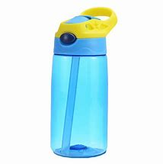

Milk and fruit
Reception children are entitled to a third of a pint of milk per day which is free of charge up to their 5th birthday.
For your child to receive milk, you will need to order from Cool Milk either online at https://www.coolmilk.com/parents/ or a hard copy form can be requested from the school. If you do not order your child’s milk via CoolMilk, your child will not receive their daily milk entitlement.
Fresh fruit or a raw vegetable snack is available mid-morning each day for children up until the end of Year 2. There is no requirement to place an order for this, it is an automatic provision.
Filled and named water bottles are really important for your child to bring into school every day. Should you forget your bottle, we have a fresh water dispenser in the unit for children to help themselves to a cup of water. Water in water bottles is our preferred choice as it is much healthier and a good habit to encourage.
Please inform us if your child has an allergy.
Notes:
HW Waterbottles – make sure it is one your child can open. Sports caps better than open bottles wit screw lid – often get spilled.

