Slide 1
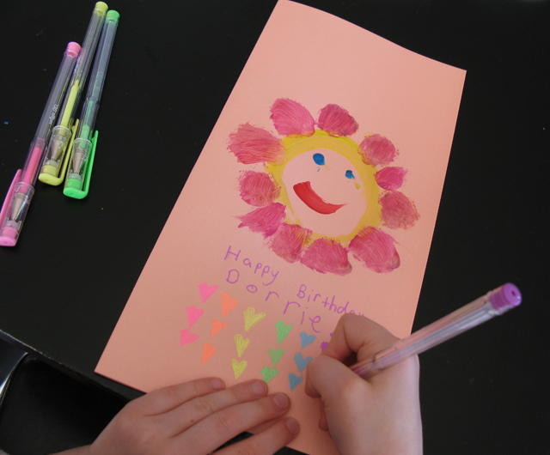


Birthdays!
As part of our commitment to being a healthy and sustainable school your child is invited to come to school wearing their own clothes on their birthday, rather than bringing in packets of sweets or treats to give out.
If you wish to do something to acknowledge the celebration with their class and support our ‘reading for pleasure’ ethos, you are invited to donate a book (new or pre-loved) which will be shared on the day and then placed in our class book corner to be looked at and shared with the children again and again. You may even like to write a special birthday message in the book!
Each child will receive a birthday card made by another child in school.

Slide 2
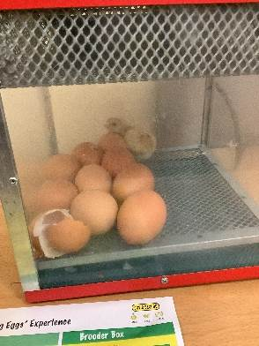
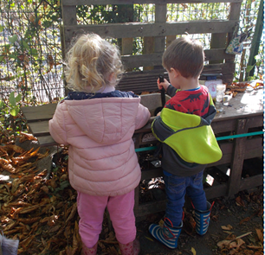
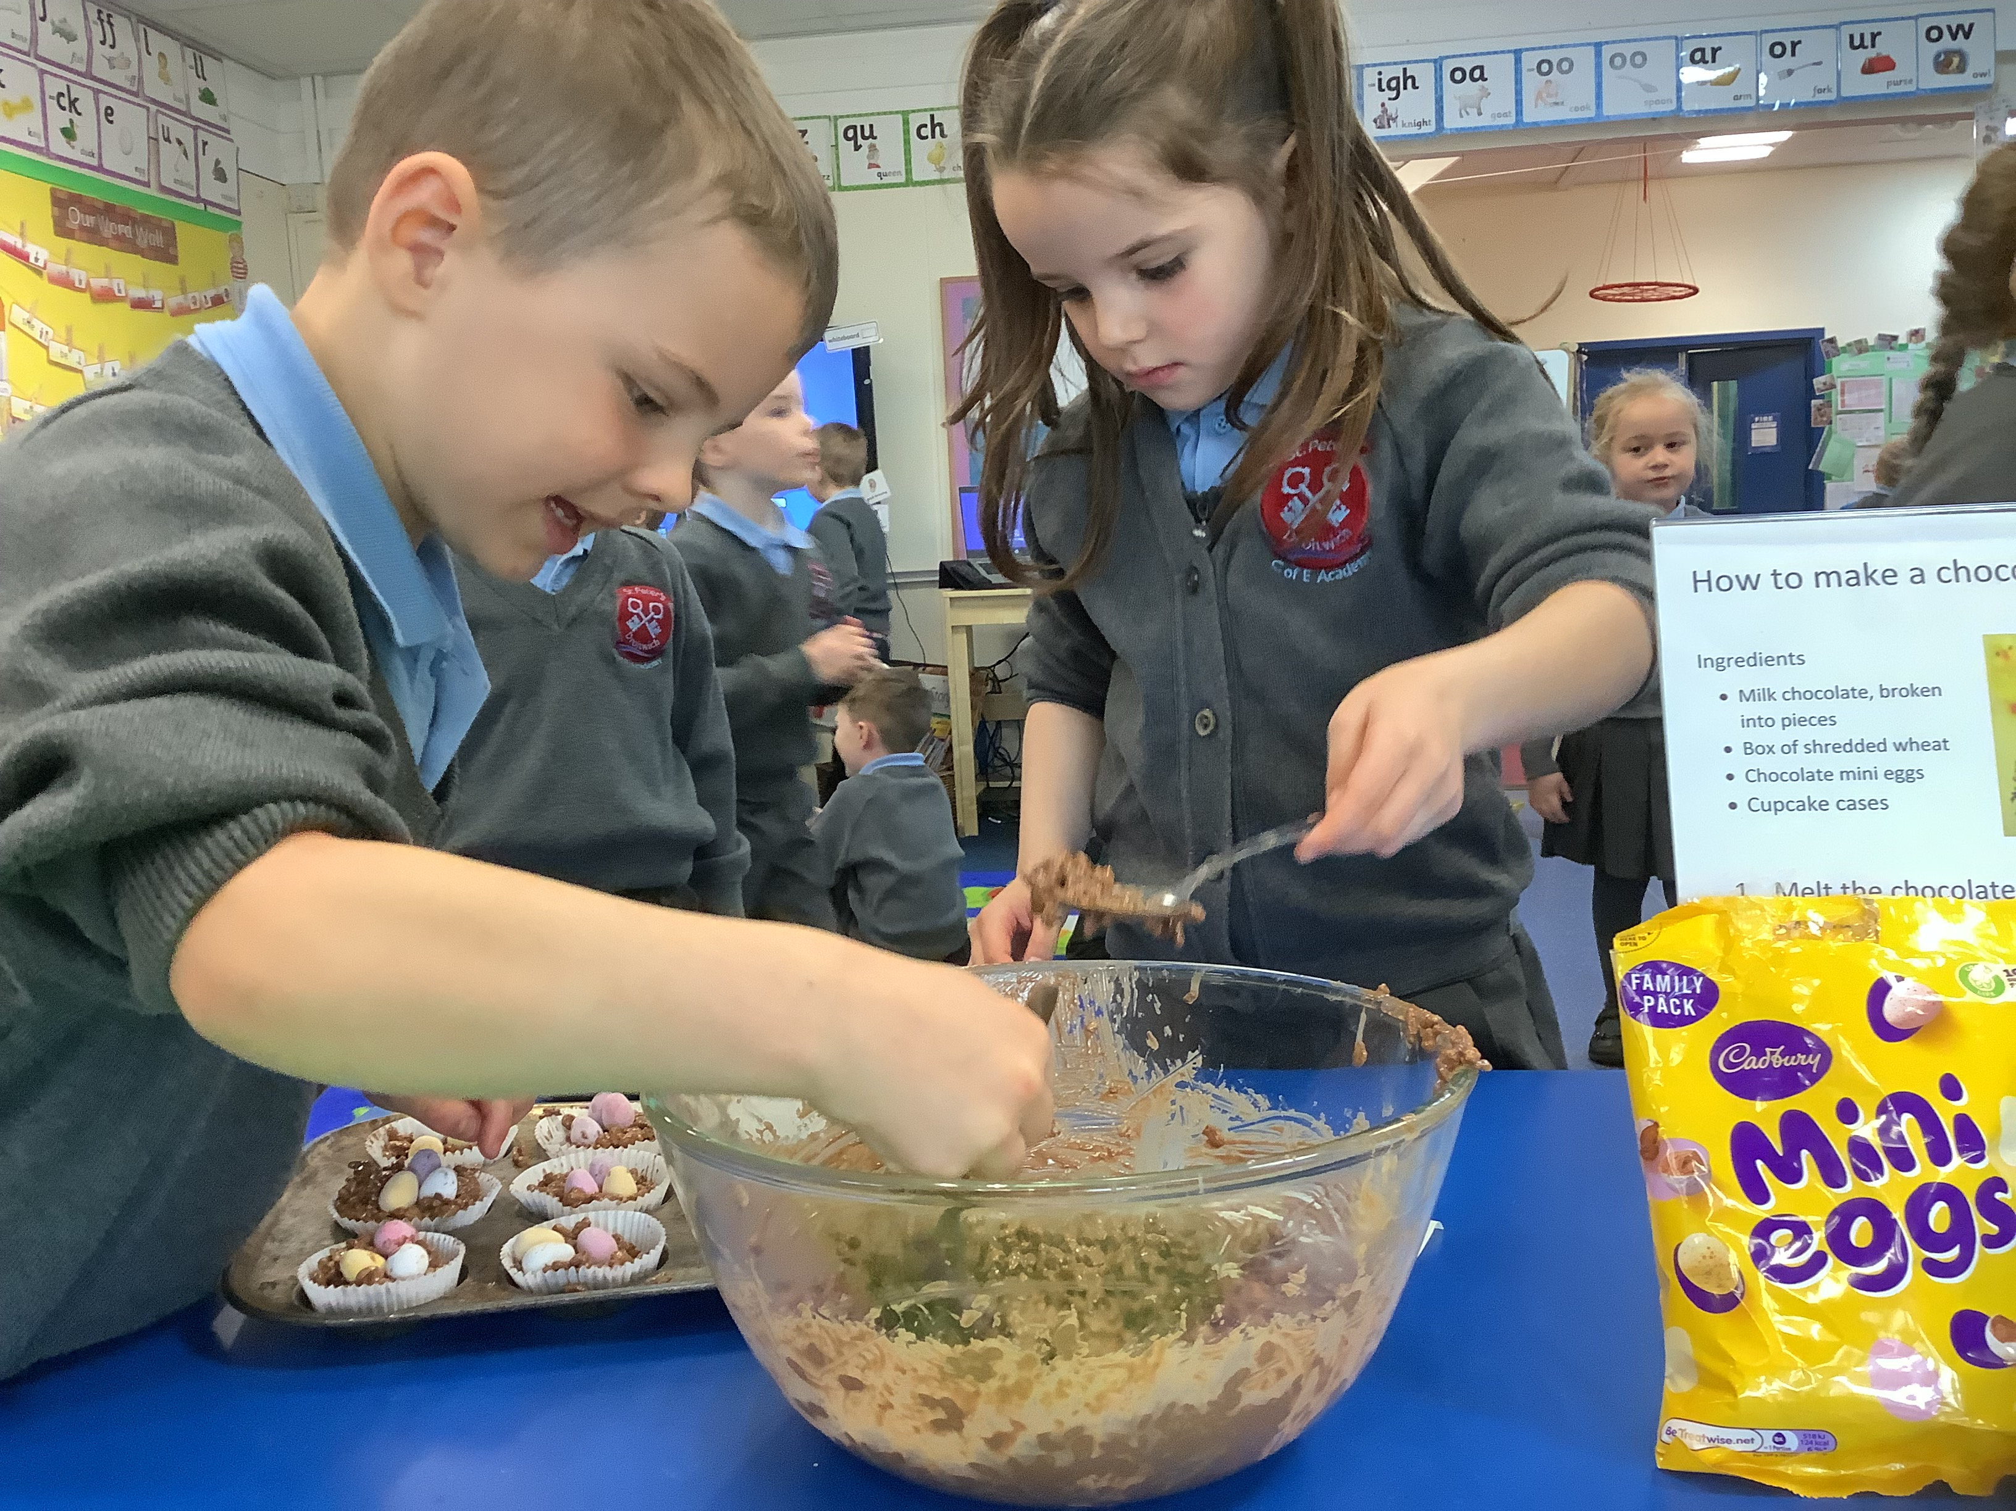
Working together
Early Years’ Fund
Our Early Years’ Fund covers the cost of additional resources. These include additional opportunities to enrich the curriculum e.g., school visits, food tasting, sandwich making, enhanced provision toys, dough making, bulbs, seeds and some unusual arts and craft materials.
We would be grateful if all families could make a contribution of £15.00 to cover the year in order to provide these extra items for the children. This contribution can be made via ParentPay.
Notes:
HW – talk through slide

Slide 3
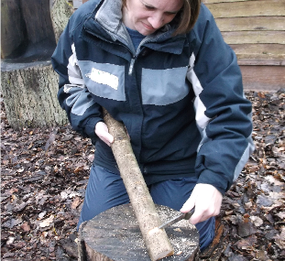
Working together
Forest School
As well as having daily access to our EYFS outdoor learning area, all children will attend forest school on site led by Mrs Keen. Each week, 15 children will join Mrs Keen and her team of forest school leaders in a variety of outdoor activities. The children will take turns to attend weekly sessions for half a term. A letter will be sent home to let you know when your child will start their sessions. They will need to wear suitable, warm clothing on forest school days and bring named wellingtons in a bag.
Notes:
HW – talk through slide

